Slide 1







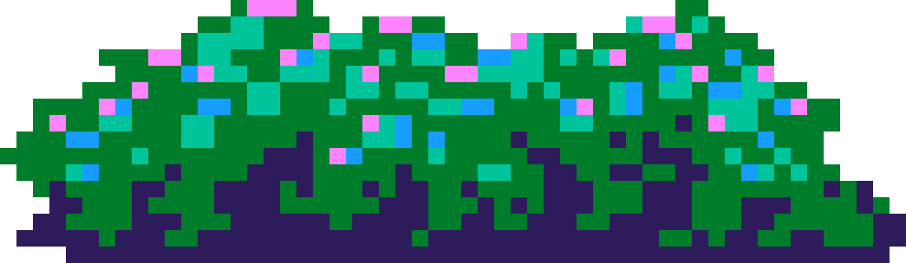

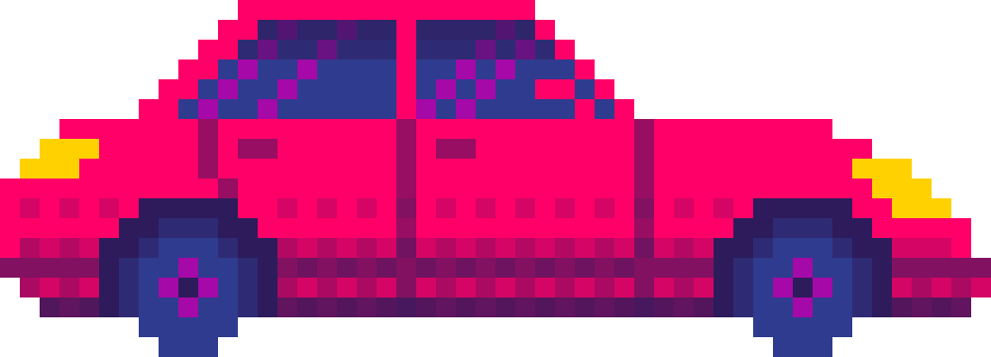
GAMIFIED DIGITAL DETOX
&
STUDY FOCUS APP
presented by
Hack Ops
TEAM MEMBERS: UDITA KAUSHIK
LAKSHYA SHARMA

Slide 2

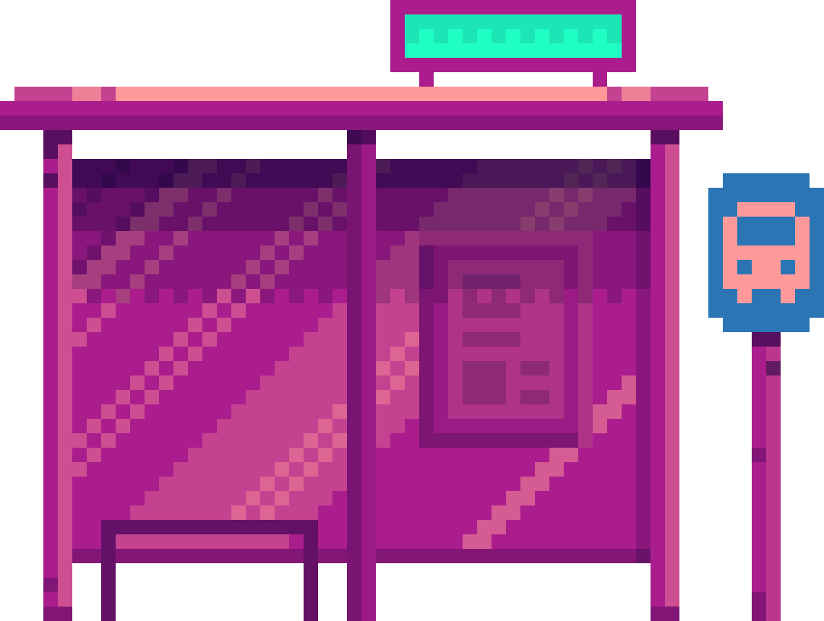
INTRODUCTION
In the hyperconnected world of the present, repeated smartphone use and digital distractions kill productivity and sanity. Our Gamified Digital Detox & Study Focus App battles this issue on its own level by encouraging quality study sessions by means of appealing gamification. With an internal timer, rewards system, and minimalistic UI, users will be motivated not to use distracting apps and be more focused at the same time—while receiving points and forging good habits.

Slide 3



ABOUT OUR VISION
IN OUR QUEST TO WEAVE ENCHANTMENT INTO THE APP, WE ASPIRE TO ELEVATE ENGAGEMENT AND JOY BY INTEGRATING INTERACTIVE WONDERS LIKE A LEADERBOARD AND SHIMMERING MEDALS. THIS ILLUSTRIOUS LEADERBOARD WILL SHOWCASE THE CHAMPIONS AMONG USERS, CELEBRATING THEIR FOCUS SESSIONS AND THE POINTS THEY ACCUMULATE. BY TRANSFORMING PRODUCTIVITY INTO A SPIRITED COMPETITION, USERS WILL BE INSPIRED TO REMAIN STEADFAST, CONTINUALLY CHALLENGING THEMSELVES AND THEIR FELLOW ADVENTURERS. GAMIFYING THE ART OF FOCUS AND THE JOURNEY OF DIGITAL DETOX NOT ONLY CULTIVATES HEALTHY HABITS BUT ALSO ENRICHES THE ENTIRE EXPERIENCE, FOSTERING A VIBRANT AND COMMUNAL SPIRIT.

Slide 4
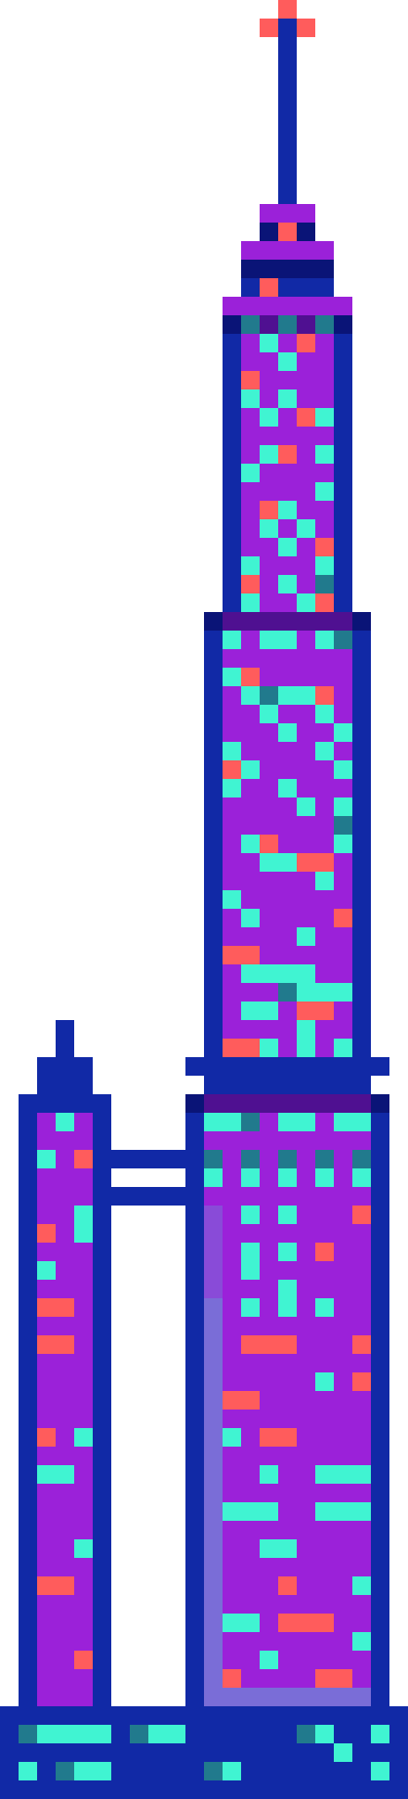
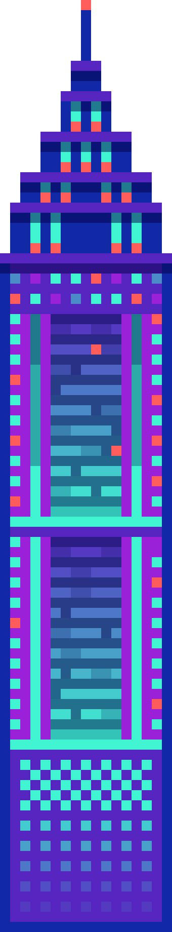
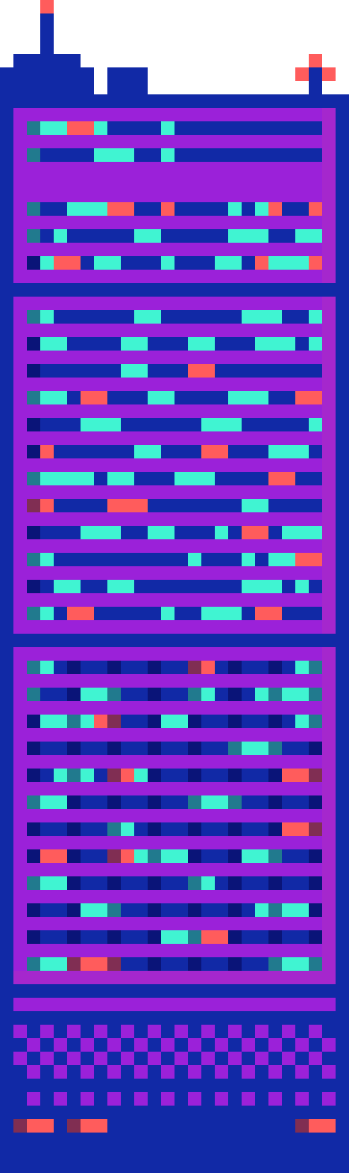
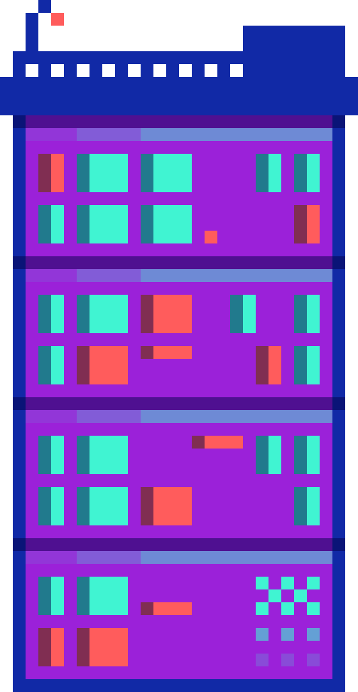

HOW WE PLAN TO IMPLEMENT:
In order to further boost the productivity of our digital detox and study concentration app, we intend to capitalize on Android's inherent Focus Mode and Digital Wellbeing APIs. Focus Mode assists users in silencing distracting applications by briefly turning them off, enabling them to focus more effectively. With integration with such system features, our app can track how long the user spends in Focus Mode, assistive to provide an accurate measurement of distraction-free time. Also, using Digital Wellbeing metrics, we plan to monitor total screen time, app use patterns, and unlock frequency in order to make meaningful insights. Real-time monitoring will enable us to award points, identify patterns of improvement, and offer personal recommendations, while promoting healthier digital habits through gamification.
L

Slide 5
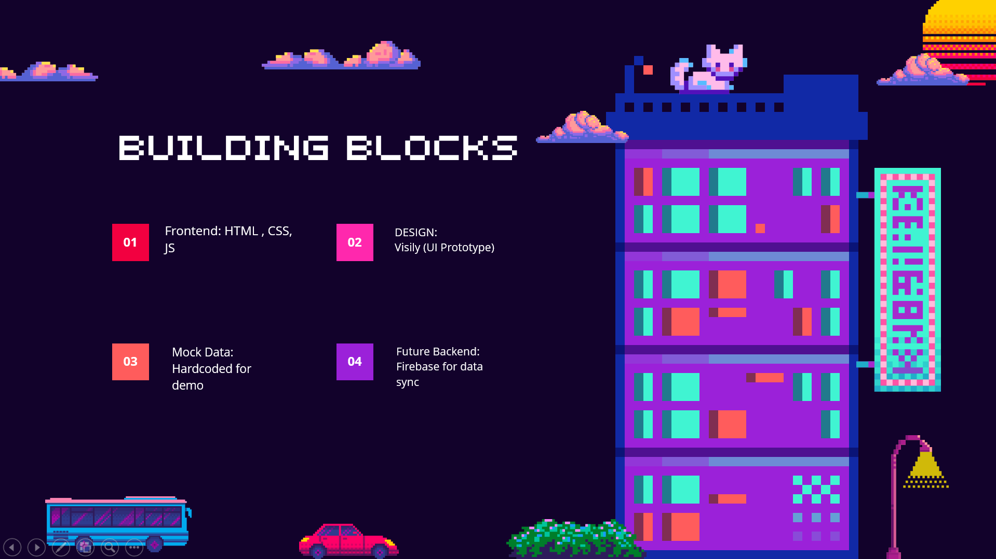

Slide 6

WAYS WE STAND OUT:
01
We will ask the user to give us permission such as permission to monitor battery usage and access to digital well-being data to monitor the user’s usage in order to get the user reality of how much time they are actually focused.
We will send notifications with motivational quotes the user from time to time in-order to get them back on the grind.
02
03
Through our app we’ll also encourage the user to turn the focus mode on to keep the distracting apps away.

Slide 7


OUR MISSION
OUR NOBLE QUEST IS TO EMPOWER STUDENTS AND INDIVIDUALS TO RECLAIM THEIR FOCUS, CASTING ASIDE THE CHAINS OF DIGITAL DISTRACTIONS THROUGH A VIBRANT, GAMIFIED REALM. BY INTERTWINING PRODUCTIVITY ENCHANTMENTS LIKE FOCUS SESSIONS WITH DELIGHTFUL REWARDS, SPIRITED LEADERBOARDS, AND METICULOUS USAGE TRACKING, WE ASPIRE TO CRAFT A CAPTIVATING AND EFFECTIVE TOOL THAT NURTURES MINDFUL DEVICE ENGAGEMENT AND FOSTERS IMPROVED STUDY HABITS. THROUGH THIS ENCHANTING ENDEAVOR, WE SEEK TO TRANSFORM DIGITAL WELL-BEING INTO NOT MERELY A NECESSITY—BUT A THRILLING ADVENTURE.

Slide 8
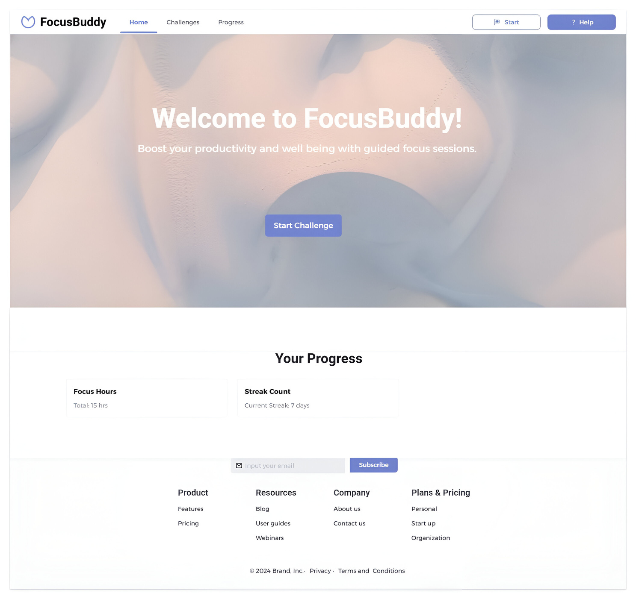

UI PROTOTYPE:
HOME PAGE

Slide 9
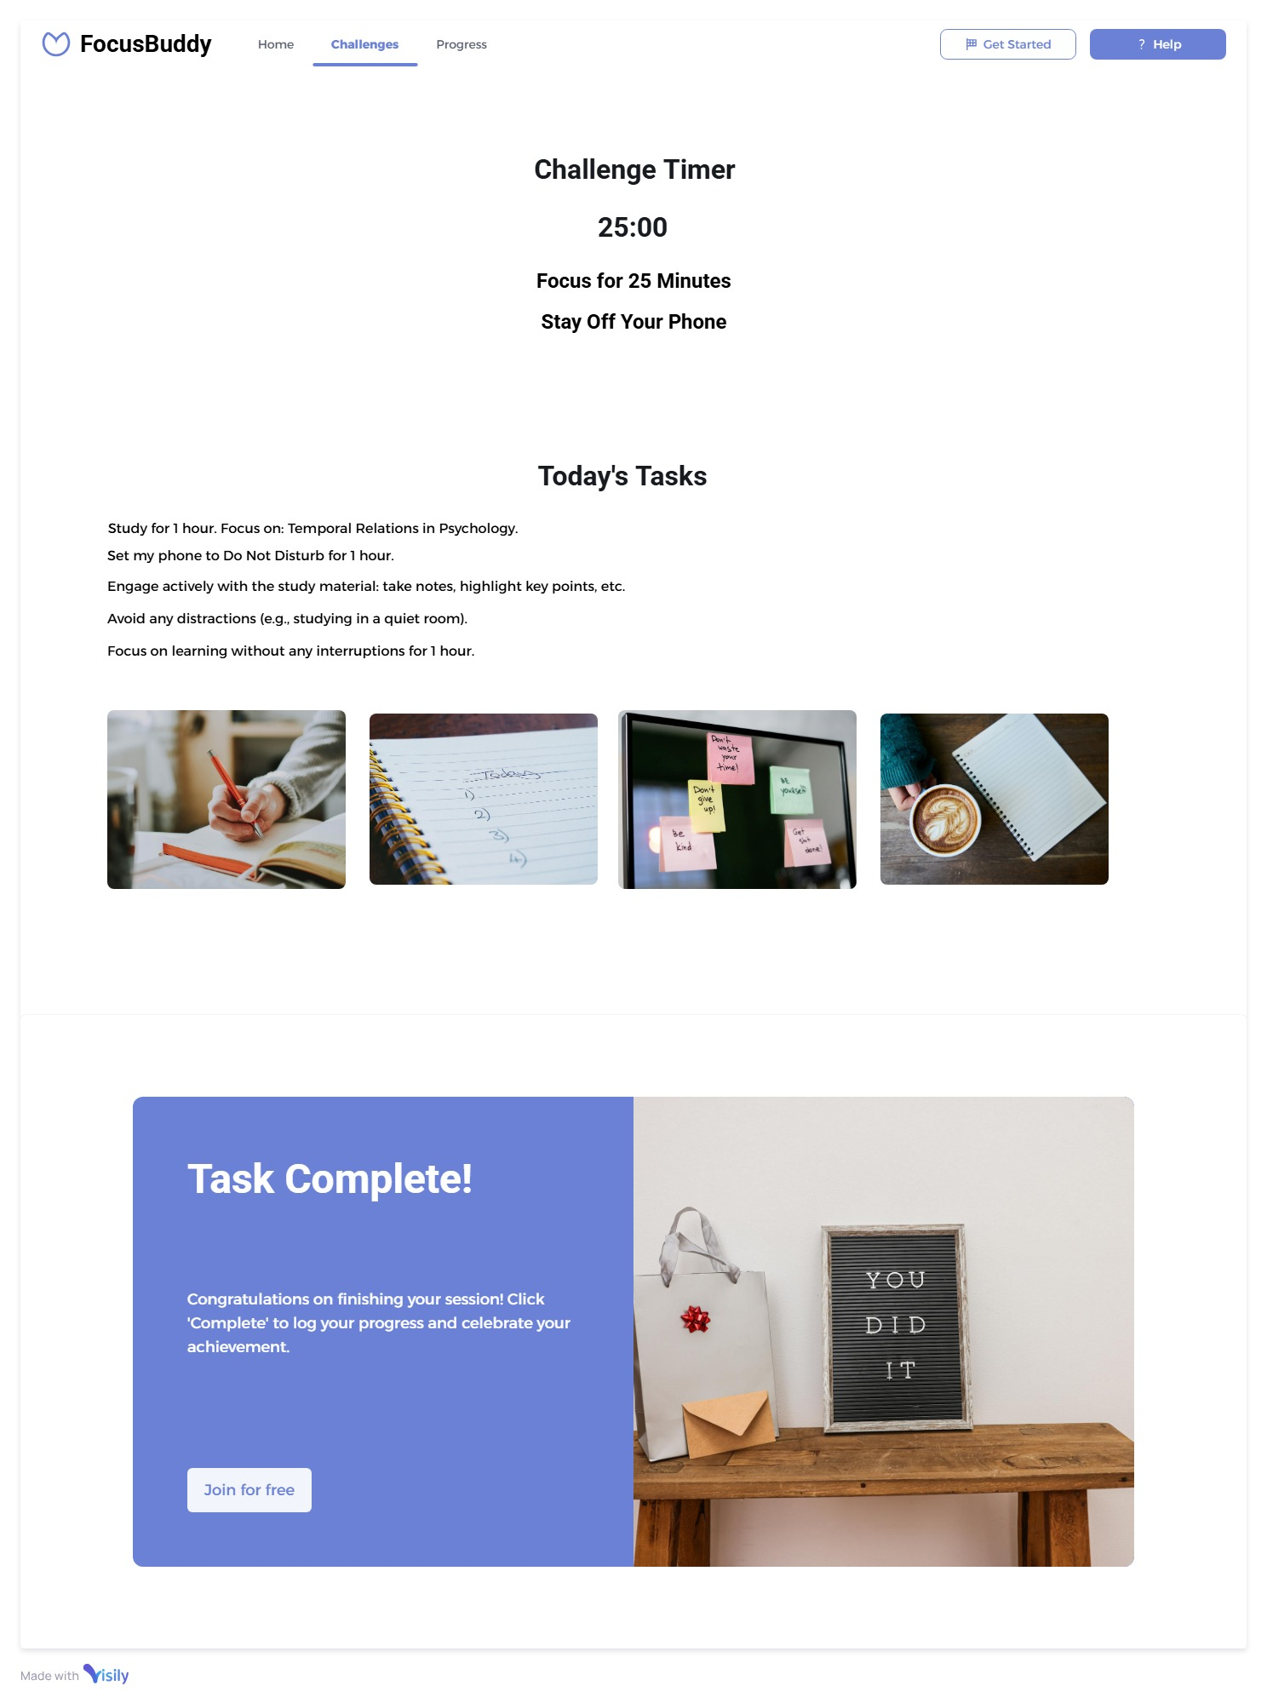
CHALLENGE
PAGE

Slide 10
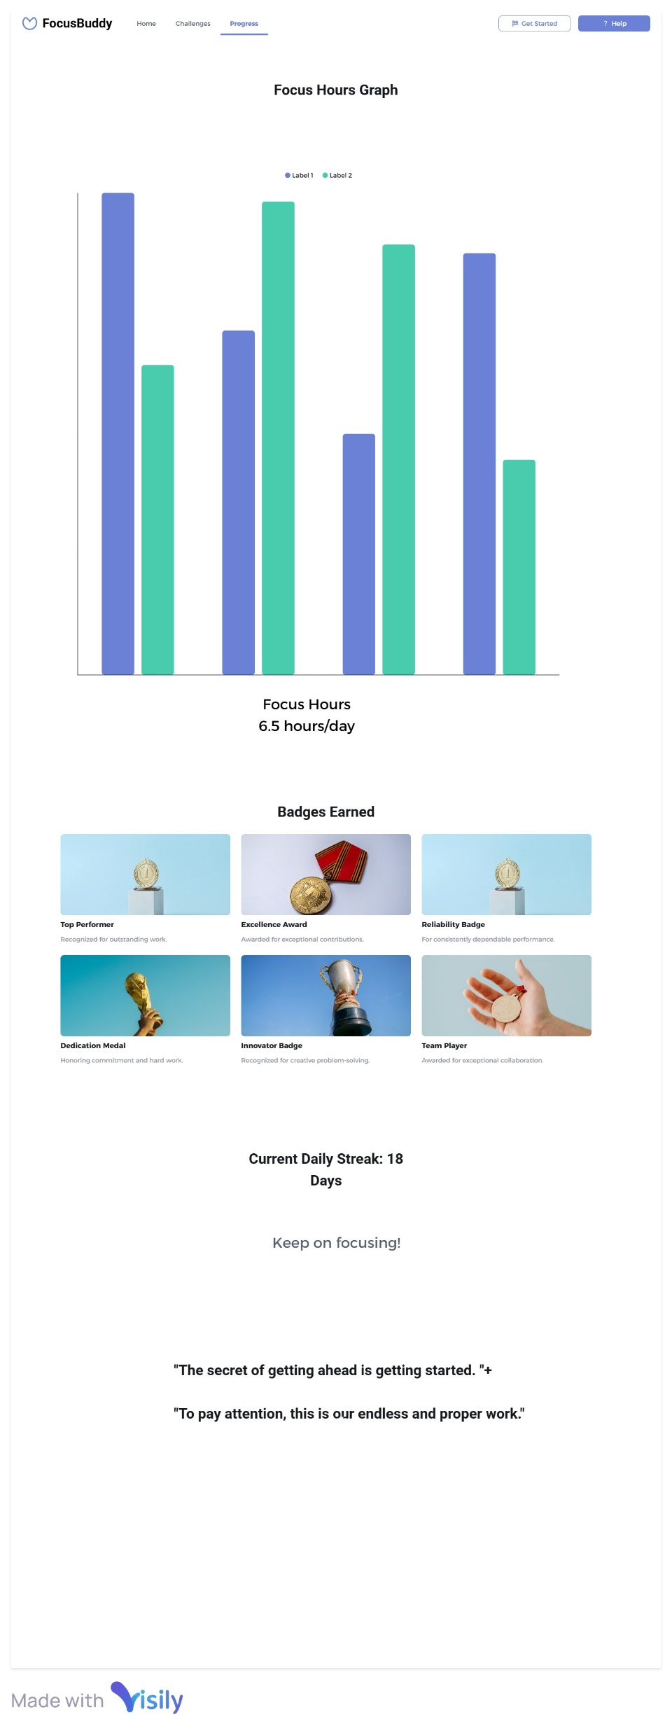
PROGRESS
PAGE

Slide 11
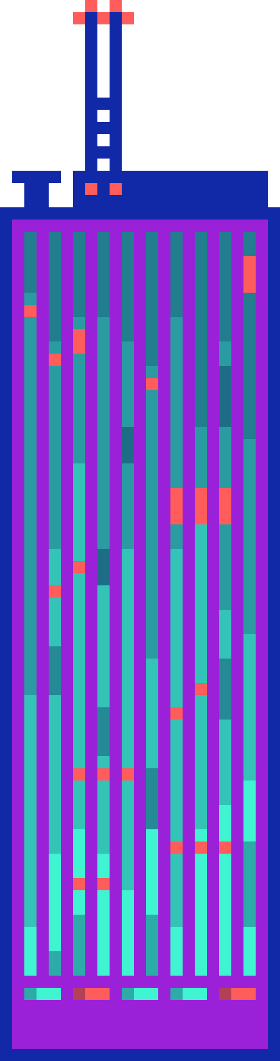
THANK
YOU

